Slide 1
Addressing Policy Fragmentation in the ATM Sector: Overcoming the Single European Sky Gridlock through Innovative ATM and Data Policies Focussing on Public Purpose
Matthias Finger – EPFL, FSR
Ivan Arnold - HungaroControl

Slide 2
POLICY FRAGMENTATION and
VALUE-BASED REGULATION

Slide 3

CAPACITY CRISIS
Overstretched ATM Infrastructure
Reaching its limits
Need for more ATM capacity which current infrastructure cannot provide
A market failure

Slide 4
OTHER CHALLENGES
”Every twenty-first-century company is a technology company.
And as a tech company, every company is now, like it or not, in competition with every other tech company.”
(Reid Hoffman – Linkedin co-founder)

Slide 5
STILL MORE CHALLENGES
Climate change: Aviation fuel tax would cut CO2 & not hit jobs,
leaked EU Commission report finds
By Alice Tidey • last updated: 13/05/2019 - 14:11
”Imposing taxes on aviation fuel would reduce the sector's carbon emissions by 11% and have a "negligible" impact on employment and the economy, a leaked study from the European Commission has found.”
”According to the report, applying a tax of €330 per 1,000 litres of kerosene — the EU's minimum excise duty rate for the fuel — would result in a ticket price increase of 10% and an 11% decrease in passenger numbers.”
Source: Euronews

Slide 6
AT THE SAME TIME…
  Aviation is considered to be one of the main catalyists of economic growth
  Mobility is a value
  States hold on to their traditional sovereign functions
  Why aviation needs to be the first mover in tackling climate change when other sectors carry on business as usual?

Slide 7
SES POLICY OBJECTIVES
BEFORE
HLG 1 and HLG 2
  FROM
  a less efficient State-based ATM sector and infrastructure
  TO
  a more efficient (modernized),
  State-based ATM sector and infrastructure
TODAY
Wise Persons Group
  FROM
  a less efficient State-based ATM sector and infrastructure
  TO
  a brand new, supra-national aviation system and infrastructure, increasingly based on market mechanisms
More imminent global challenges
Notes:
This in itself involves considerable legal and infrastructural changes
Plus global challenges
ATM policy cannot be viewed in isolation any longer

Slide 8
COMPLEXITY
Legal aspect
State obligations under the Chicago Convention
Lack of legal framework for DATA
Liability concerns
Technology
Revolutionary innovation
Brexit
Other EU policies
Global Challenges
Climate change
Disruption
An increasingly uncertain global environment
ATM Policy
Delivery of public goods
  Safety
  Mobility
  Capacity
  Environment
  Economic growth
  Competition
Infrastructure
Competences
  EU v MSs
Governance
  Public v Private
State functions v Market
Market aspect
New entrants, new markets, globalization
  Drones
  Higher Airspace operations
  Digital infrastructure providers
  New types of services
Tech industry may rewrite how ATM is provided
  New digital platforms
  Automation
  Virtualization
Disappearing sectoral boundaries
’Capacity
crisis’
The policy maker/regulator has a duty to act, especially to ensure the delivery of public goods that the market would not deliver without State intervention:
  Economic regulation
  Non-economic regulation
Notes:
Potentil dosaggregation of the ATM sector itself
Defragmentation at the level of the digital economy

Slide 9
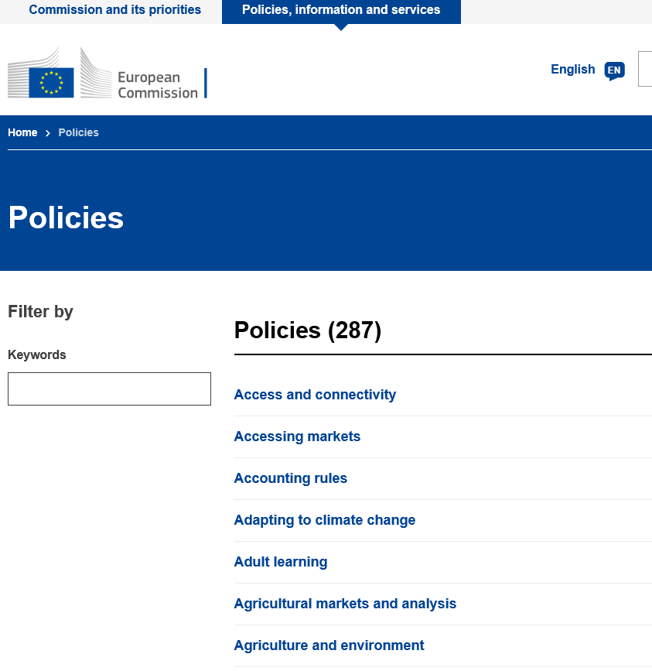
INTERDEPENDENCE
ATM policy
cannot be viewed in isolation.

Slide 10
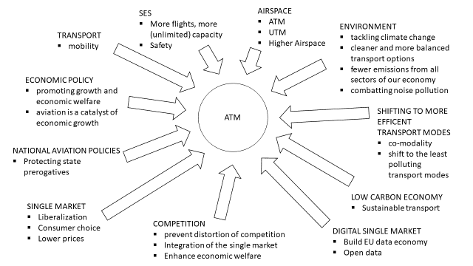
Policy fragmentation in the broader policy environment
ATM

Slide 11
THE PROBLEM WITH POLICY FRAGMENTATION
POLICY FAILURES
  not achieving the policy objective
  impossibility of implementation
CONTRADICTING LEGISLATION
LEGAL UNCERTAINTY
  competing interpretations of existing rules
DIFFICULTIES OF IMPLEMENTATION
  implementing agencies have to arbitrate priorities themselves
  & may work against each other
POLICY INCONSISTENCIES
POLICY COLLISIONS

Slide 12
VALUE-BASED REGULATION
IMPLEMENTATION
REGULATION
Clear allocation of roles and accountability
Innovative regulatory solutionsions from other sectors
(e.g.: electricity), sectoral data regulation, etc.
POLICY
Clear, harmonized policy objectives
Automation of …, Liberalization of …, Reduction of CO2 emmissions by …, DATA exchange, addressing congestion through pricing, optimized infrastructure, etc.
PUBLIC VALUE BASIS
Recognize interdependencies
Prioritize and balance where necessary
MOBILITY, ECONOMIC GROWTH, ENVIRONMENT, SAFETY, SECURITY,
INNOVATION, CLEAN AIR, DEFENCE, COMPETITION, CLIMATE, INFRASTRUCTURE , etc.
Supported by:
Digital tools informing decision-making at the policy, regulatory and implemetation level
Ensuring access to relevant information
Addressing information deficit and asymmetries

Slide 13
ELECTRICITY

Slide 14
Electricity fragmentation
Characteristics:
Electricity cannot be stored
Electricity flows cannot be addressed to a particular destination/ recipient
But there is a capacity problem
No military
Little unions
No Chicago Convention
Aim:
Seamless European infrastructure (“copper plate Europe”) for the free flow of electricity (internal market)
Impediments:
national TSOs, national grid standards, national investments, national regulations
limited capacity, nationally defined limitations (NTC)

Slide 15
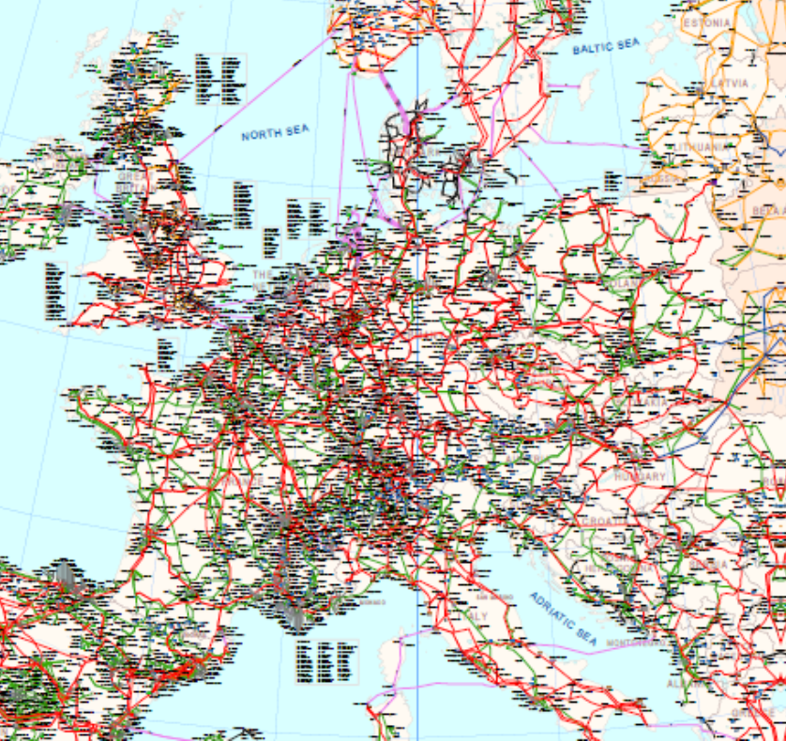
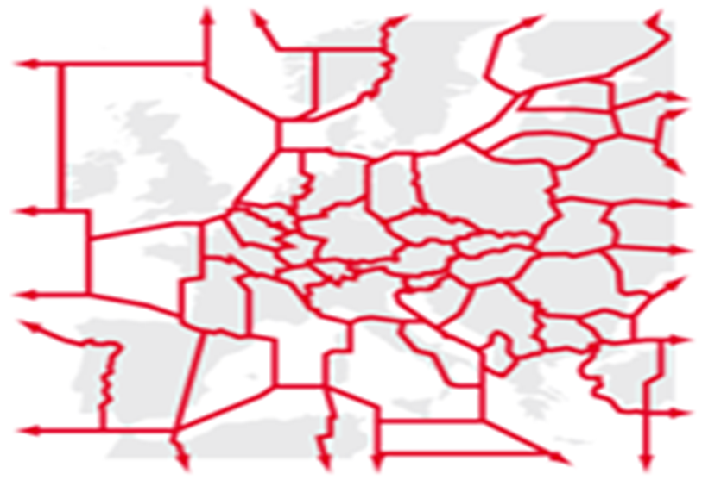
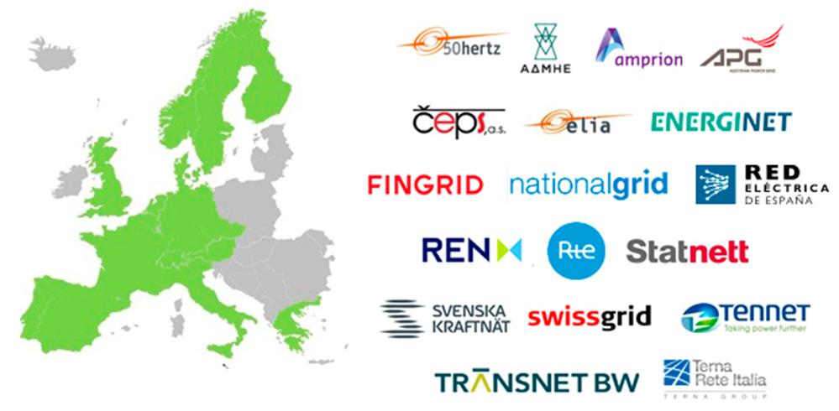
What is the problem?

Slide 16
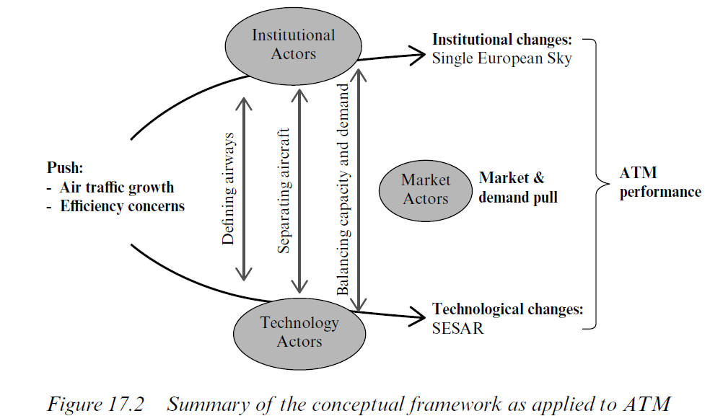
The conceptual framework
Fragmentation
EU internal market
De-fragmentation

Slide 17

Handling fragmentation in electricity
Interconnection
ENTSO-E
Coordination among TSOs; EU network development plans
Interoperability
EU technical harmonization through rules: network codes
Congestion mgmt
Capacity auctions (explicit → implicit)
→ nodal (congestion) pricing
EU regulator: ACER
System mgmt
Planning: timetables (coordination)
Execution: rules 4 balancing, redispatch
Pricing
Cost+ (→ benchmark regulation)

Slide 18
Lessons learnt for ATM
Stronger coordination among ANSPs (ENTSO-E – style)
Coordination among TSOs; EU network development plans
Need for technical standardization
EU technical harmonization through rules: network codes
Need for congestion rules and pricing (mechanisms)
Capacity auctions (explicit → implicit)
→ nodal (congestion) pricing
Need for ACER-style regulator
Need for common execution rules (currently: performance rules)
Planning: timetables (coordination)
Execution: balancing, redispatch
Separation between infrastructural costs and execution costs (and their regulation)
Cost+ (→ benchmark regulation)

Slide 19
Applying the electricity solution
Pricing of ATM: - infrastructure costs (cost+)
- execution costs (performance-based)
- congestion costs (incl. negative externalities)
Institutions: - simplification
EU regulator
Network
manager
Digital platform manager
Infrastructure
manager
Infrastructure
manager
Infrastructure
manager

Slide 20
BACKUP SLIDES

Slide 21
EXAMPLES OF POLICY INCONSISTENCIES
Internal:
Lack of clear policy objectives (ECA)
The environmental policy objective is inconsistent with the policy objective of meeting a potentially unlimited capacity demand
The safety objective could be compromised by stretching the limits of the existing infrastructure

Slide 22
EXAMPLES OF POLICY INCONSISTENCIES
Inconsistencies concerning the broader policy environment:
The objectives of a low carbon economy, tackling climate change, fewer emissions, combatting noise pollution and the shift to the least polluting transport modes seems to be in contradiction with the policy of accommodating as many flights in European airspace as there may be
The policy objective of ATM liberalization stemming from the concept of the internal market may contradict policy objectives of Member States that intend to define certain functions as state prerogatives
The increasing presence of market forces in the sector could make it more difficult to guarantee socially desirable outcomes and the delivery of certain public goods
The policy objective of supporting industrial partnerships and empowering industry through granting more decision-making powers to industry stakeholders over key ATM infrastructure and operations may contradict the competition policy objective of the prevention of the distortion of competition (building blocks of market power)
The policy objective of digitalizing the Single European Sky raises the need for data concentration, which in turn may raise competition policy concerns, especially in case the data is accumulated by private companies

Slide 23
Disruption
Potential sources of disruption in ATM:
Revolutionary innovation as opposed to evolutinary innovation
Evolving new infrastructures
Dissolution of the traditional aviation value chain, dissolution of the ATM setor
New business models
Climate change
Policy and regulatory objective: avoiding policy/regulatory disruption, considering
Disruptive forces external to the sector need to be monitored from a regulatory perspective
Effects of automation on operations and change of the human role
The technological vision should probably go beyond improving legacy infrastructure
New forms of public-private partnerships may need to be explored to address the disruption issue

Slide 24
DATA
    EU Agency?
    PPP?
ATM Data
Governance
Potential responsibilities:
  Collect, organize and structure data
  Enforce DATA rules
  Define access points
  Grant or refuse access
  Monitor relevant technological development
  Manage infrastructure
DATA
as ATM Infrastructure
EU Digital
Legal Framework
Sectoral ATM Data Regulation
Clarify:
  Data “ownership”:
  Clarify who controls data
  Classify data: public/restricted
  Define purpose-limitation rules (commercial use, R&D, etc.)
  Define access criteria
  Define safety, security, data quality requirements

Slide 25
Competition Law and EU public services
Need to better understand the evolving concept of public interest in ATM:
    State obligations – Chicago convention: facilitating aviation
    Safety, security, defence
    Economic regulation (monopolies)
    Potential for policy objectives wider than ATM and aviation
This aspect of ATM is clearly changing
The public interest aspect of an activity may determine its legal nature:
    State Prerogative OR - different rules apply
    Economic Activity - different behaviour is expected
Today, several ATM-related activities oscillate between the public and private domain
Most of these could be structured both ways legally
Potential for defining services as EU prerogatives or SGEI at the EU level

Slide 26
Key Recommendations
Define the Public Values underlying the SES policy and redifine Policy Objectives
Clearly allocate competences between the EU, MSs and EUROCONTROL
Clearly distinguish public functions from economic activities
Consider establishing services as EU prerogatives or SGEI
Consider sectoral DATA legislation and DATA as infrastructure
Consider neighbouring EU policies (competition, environment, etc.)
Address the potential for disruption: automation, innovation, climate change
Clarify legal concepts
Clarify industry role in regulation, explore new modes of co-operation between state, industry and the civil sector
A semi-harmonized EU-wide liability regime for cross-border service provision

Slide 27
Value-based policy-making
Value based policy-making | Identify the basic values as reference points for the SES legislation (e.g.: economic growth, clean air, cheap mobility, climate, safe flights, etc.)
Harmonized policy ecosystem | Ensure the consistency of those values with the broader policy environment Prioritize where necessary in an overarching inter-sectoral context
Clear policy objectives | On the basis of the underlying values, identify and harmonize clear policy objectives (e.g.: liberalization of certain services, reduction of the environmental impact, etc.)
Clear allocation of roles and responsibilities – including accountability | Clearly allocate roles, responsibilities and functions between EU and MSs State and private industry
Clear allocation of accountability | Clearly allocate accountability for implementation and enforcement
Innovative regulatory solutions | Lessons learnt in the energy sector Innovation stimulated by regulatory thresholds and conditions Sectoral data policies New approach to pricing: congestion pricing including negative externalities Identify new modes of public-private cooperation
Supported by:
digital tools supporting decision-making at the policy and regulatory level
Such tools may ensure that decision-makers possess the necessary information to base decisions on
e.g.: intermodal EU connectivity database including negative externalities

